Slide 1

Predicting Customer Churn In the Telecommunications

Slide 2

Group members
Arafat hossain-14201023
Mohammad Abdul Hannan-14101161
Md. Maruf Rahman-14301036
Mayaz Ahmad-14101143

Slide 3
Table of content
Work plan
Dataset Analysis
Area of work
Algorithm Analysis
Code and library
Results
References

Slide 4
Work plan
Dataset Collection
Feature Selection
Fitting a model
Evaluate

Slide 5
Dataset Analysis
Account length
Call minutes
Charge incurred for service
Account duration
Customer availability

Slide 6
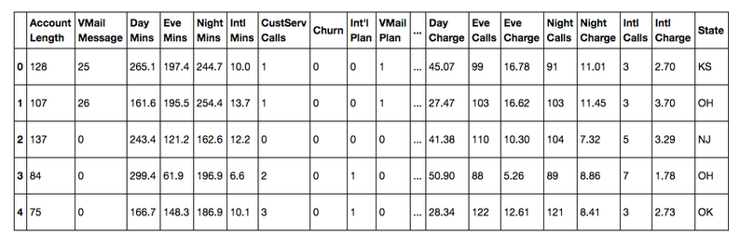
Dataset Analysis
Independent values

Slide 7
Area of work
Classification
Prediction
Customer behavior analysis

Slide 8
Algorithm Analysis
Random forest
K nearest neighbor
Support vector machine
Random forest is better based on accuracy, precision and recall.

Slide 9
Code and library
Sklearn library
Pandas
Matpolib
Shape() method
Describe() method

Slide 10
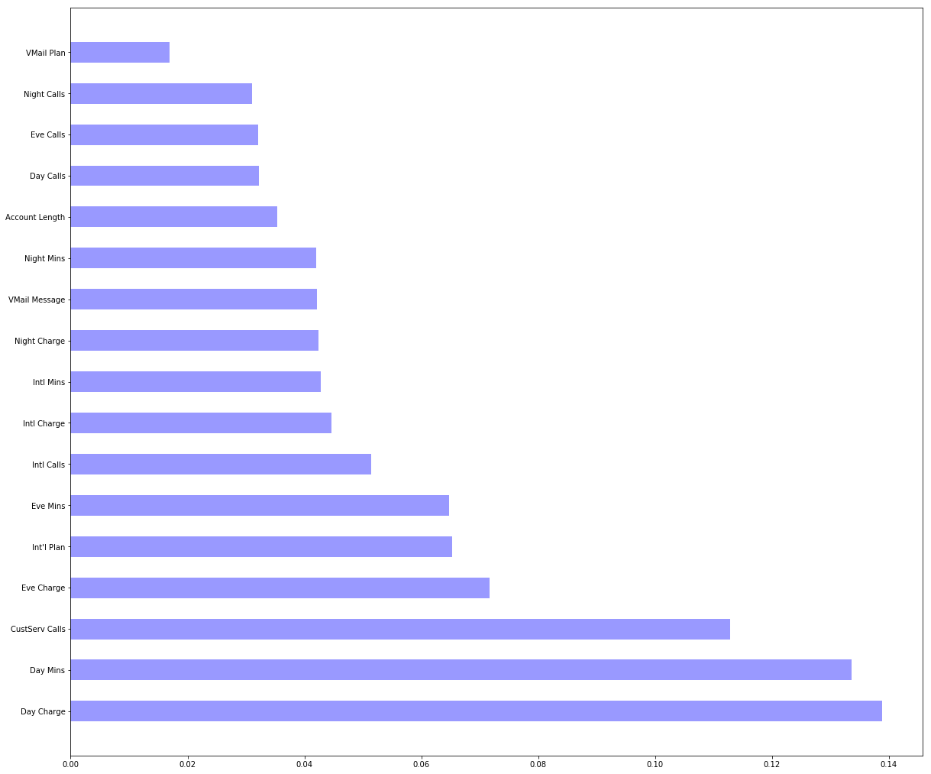
Result

Slide 11
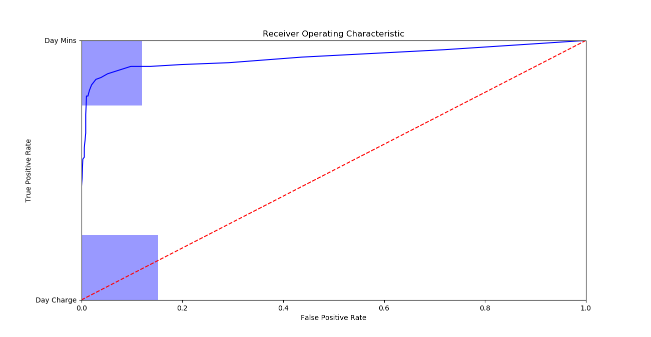
Result

Slide 12
References
Data Set(http://www.iainpardoe.com/teaching/dsc433/data.htm)
Code and information(http://blog.yhat.com/posts/predicting-customer-churn-with-sklearn.html)

Slide 13

Questions Please…

